Slide 1
Build your first app
Android Developer Fundamentals V2
Lesson 1

Slide 2
1.2 Layouts and resources for the UI

Slide 3
Contents
Views, view groups, and view hierarchy
The layout editor and ConstraintLayout
Event handling
Resources and measurements

Slide 4
Views

Slide 5
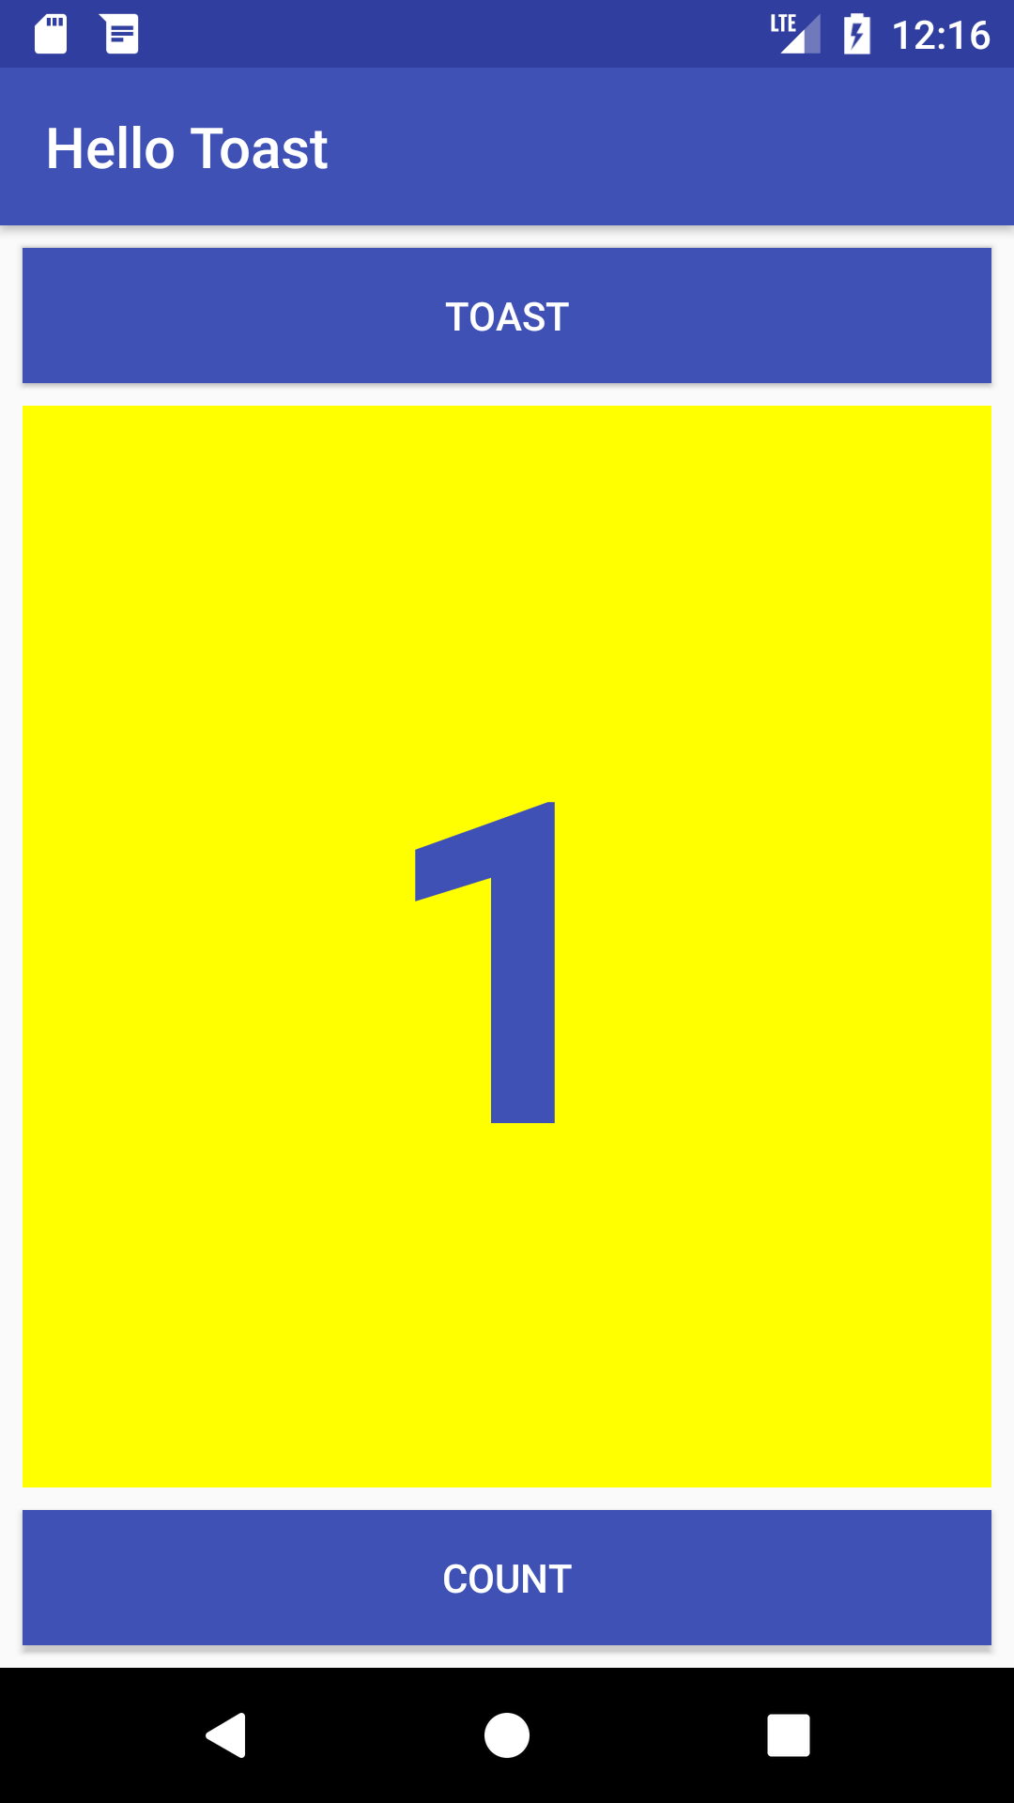
Everything you see is a view
If you look at your mobile device,
every user interface element that you see is a View.
Views

Slide 6
What is a view?
View subclasses are basic user interface building blocks
Display text (TextView class), edit text (EditText class)
Buttons (Button class), menus, other controls
Scrollable (ScrollView, RecyclerView)
Show images (ImageView)
Group views (ConstraintLayout and LinearLayout)

Slide 7
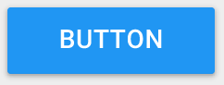

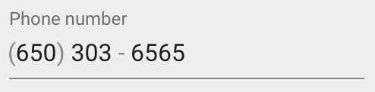

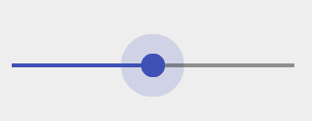
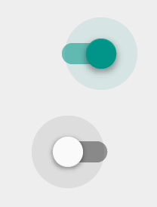
Examples of view subclasses
Button
EditText
Slider
CheckBox
RadioButton
Switch

Slide 8
View attributes
Color, dimensions, positioning
May have focus (e.g., selected to receive user input)
May be interactive (respond to user clicks)
May be visible or not
Relationships to other views

Slide 9
Create views and layouts
Android Studio layout editor: visual representation of XML
XML editor
Java code

Slide 10
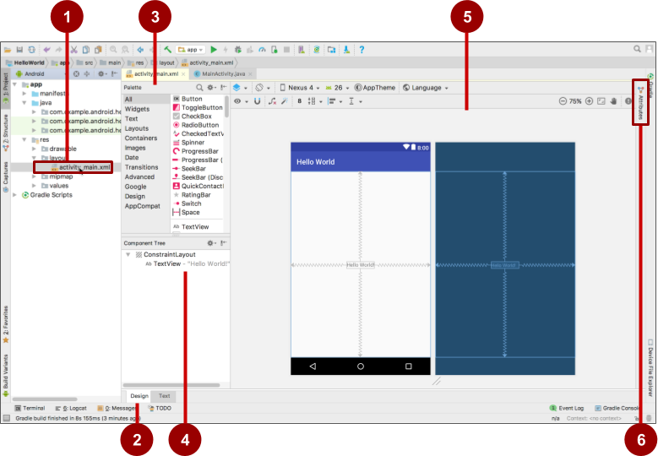
Android Studio layout editor
XML layout file
Design and Text tabs
Palette pane
Component Tree
Design and blueprint panes
Attributes tab

Slide 11
View defined in XML
<TextView
android:id="@+id/show_count"
android:layout_width="match_parent"
android:layout_height="wrap_content"
android:background="@color/myBackgroundColor"
android:text="@string/count_initial_value"
android:textColor="@color/colorPrimary"
android:textSize="@dimen/count_text_size"
android:textStyle="bold"
/>

Slide 12
View attributes in XML
android:<property_name>="<property_value>"
Example: android:layout_width="match_parent"
android:<property_name>="@<resource_type>/resource_id"
Example: android:text="@string/button_label_next"
android:<property_name>="@+id/view_id"
Example: android:id="@+id/show_count"

Slide 13
Create View in Java code
context
In an Activity:
TextView myText = new TextView(this);
myText.setText("Display this text!");

Slide 14
What is the context?
Context is an interface to global information about an application environment
Get the context:
Context context = getApplicationContext();
An Activity is its own context: TextView myText = new TextView(this);

Slide 15
Custom views
Over 100 (!) different types of views available from the Android system, all children of the View class
If necessary, create custom views by subclassing existing views or the View class

Slide 16
ViewGroup and View hierarchy

Slide 17
ViewGroup contains "child" views
ConstraintLayout: Positions UI elements using constraint connections to other elements and to the layout edges
ScrollView: Contains one element and enables scrolling
RecyclerView: Contains a list of elements and enables scrolling by adding and removing elements dynamically

Slide 18
ViewGroups for layouts
Layouts
are specific types of ViewGroups (subclasses of ViewGroup)
contain child views
can be in a row, column, grid, table, absolute

Slide 19




Common Layout Classes
LinearLayout
ConstraintLayout
GridLayout
TableLayout

Slide 20
Common Layout Classes
ConstraintLayout: Connect views with constraints
LinearLayout: Horizontal or vertical row
RelativeLayout: Child views relative to each other
TableLayout: Rows and columns
FrameLayout: Shows one child of a stack of children

Slide 21
Class hierarchy vs. layout hierarchy
View class-hierarchy is standard object-oriented class inheritance
For example, Button is-a TextView is-a View is-an Object
Superclass-subclass relationship
Layout hierarchy is how views are visually arranged
For example, LinearLayout can contain Buttons arranged in a row
Parent-child relationship

Slide 22
Hierarchy of viewgroups and views
ViewGroup
Root view is always a ViewGroup
ViewGroup
View
View
View
View
View

Slide 23
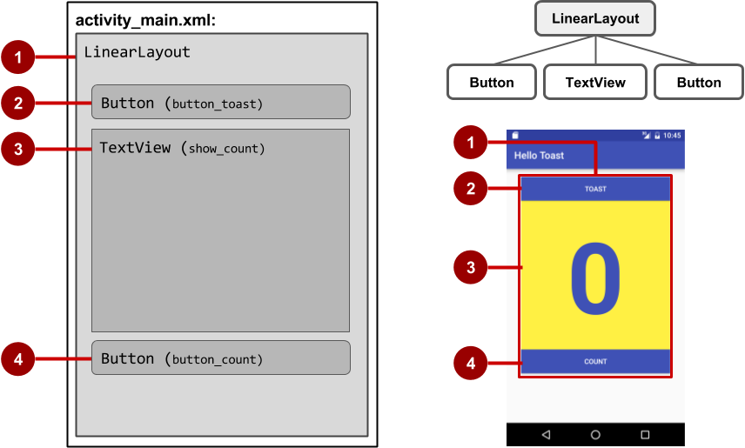
View hierarchy and screen layout

Slide 24
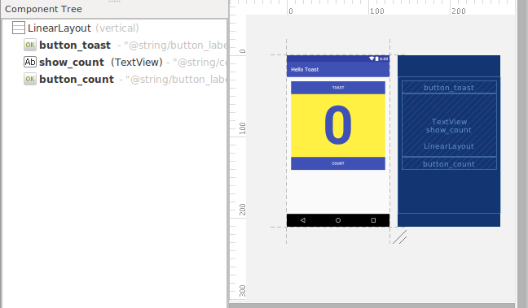
View hierarchy in the layout editor

Slide 25
Layout created in XML
<LinearLayout
android:orientation="vertical"
android:layout_width="match_parent"
android:layout_height="match_parent">
<Button
... />
<TextView
... />
<Button
... />
</LinearLayout

Slide 26
Layout created in Java Activity code
LinearLayout linearL = new LinearLayout(this);
linearL.setOrientation(LinearLayout.VERTICAL);
TextView myText = new TextView(this);
myText.setText("Display this text!");
linearL.addView(myText);
setContentView(linearL);

Slide 27
Set width and height in Java code
Set the width and height of a view:
LinearLayout.LayoutParams layoutParams =
new Linear.LayoutParams(
LayoutParams.MATCH_PARENT, LayoutParams.MATCH_CONTENT);
myView.setLayoutParams(layoutParams);

Slide 28
Best practices for view hierarchies
Arrangement of view hierarchy affects app performance
Use smallest number of simplest views possible
Keep the hierarchy flat—limit nesting of views and view groups

Slide 29
The layout editor and Constraint Layout

Slide 30
The layout editor with ConstraintLayout
Connect UI elements to parent layout
Resize and position elements
Align elements to others
Adjust margins and dimensions
Change attributes

Slide 31
What is ConstraintLayout?
Default layout for new Android Studio project
ViewGroup that offers flexibility for layout design
Provides constraints to determine positions and alignment of UI elements
Constraint is a connection to another view, parent layout, or invisible guideline

Slide 32
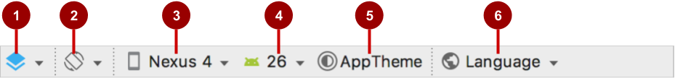
Layout editor main toolbar
Select Design Surface: Design and Blueprint panes
Orientation in Editor: Portrait and Landscape
Device in Editor: Choose device for preview
API Version in Editor: Choose API for preview
Theme in Editor: Choose theme for preview
Locale in Editor: Choose language/locale for preview

Slide 33
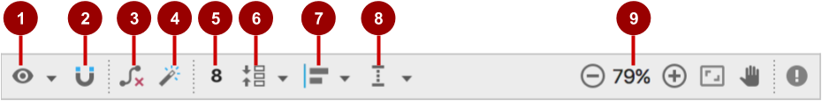
ConstraintLayout toolbar in layout editor
Show: Show Constraints and Show Margins
Autoconnect: Enable or disable
Clear All Constraints: Clear all constraints in layout
Infer Constraints: Create constraints by inference
Default Margins: Set default margins
Pack: Pack or expand selected elements
Align: Align selected elements
Guidelines: Add vertical or horizontal guidelines
Zoom controls: Zoom in or out

Slide 34

Autoconnect
Enable Autoconnect in toolbar if disabled
Drag element to any part of a layout
Autoconnect generates constraints against parent layout

Slide 35
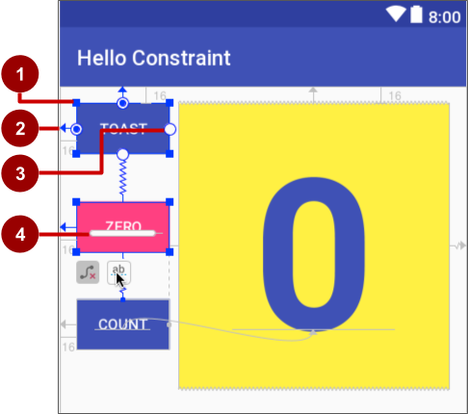
ConstraintLayout handles
Resizing handle
Constraint line and handle
Constraint handle
Baseline handle

Slide 36

Align elements by baseline
Click the baseline constraint button
Drag from baseline to other element's baseline

Slide 37
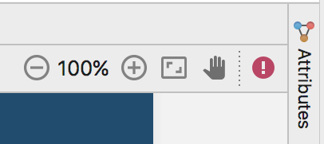
Attributes pane
Click the Attributes tab
Attributes pane includes:
Margin controls for positioning
Attributes such as layout_width

Slide 38
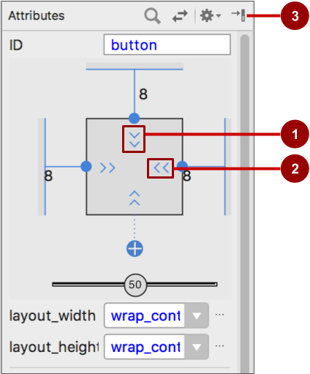
Attributes pane view inspector
Vertical view size control specifies layout_height
Horizontal view size control specifies layout_width
Attributes pane close button

Slide 39



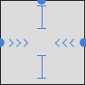
Layout_width and layout_height
layout_width and layout_height change with size controls
match_constraint: Expands element to fill its parent
wrap_content: Shrinks element to enclose content
Fixed number of dp (density-independent pixels)

Slide 40

Set attributes
To view and edit all attributes for element:
Click Attributes tab
Select element in design, blueprint, or Component Tree
Change most-used attributes
Click at top or View more attributes at bottom to see and change more attributes

Slide 41
Set attributes example: TextView

Slide 42


Preview layouts
Preview layout with horizontal/vertical orientation:
Click Orientation in Editor button
Choose Switch to Landscape or Switch to Portrait
Preview layout with different devices:
Click Device in Editor button
Choose device

Slide 43
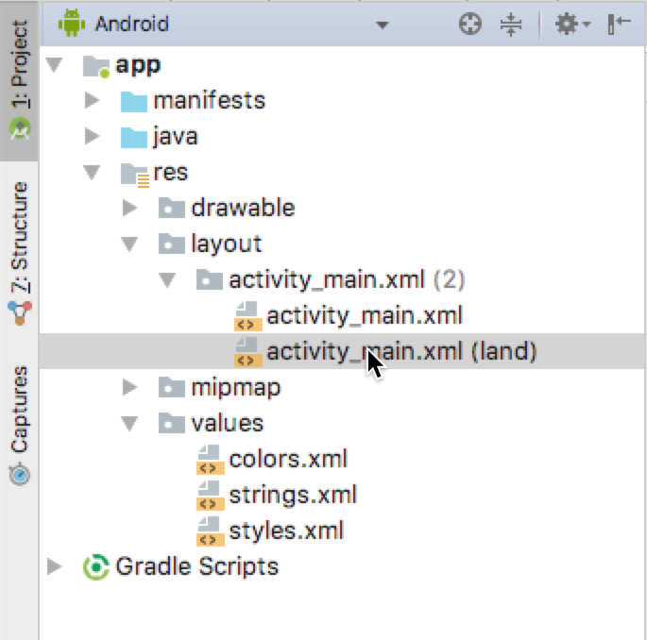
Create layout variant for landscape
Click Orientation in Editor button
Choose Create Landscape Variation
Layout variant created: activity_main.xml (land)
Edit the layout variant as needed

Slide 44
Create layout variant for tablet
Click Orientation in Layout Editor
Choose Create layout x-large Variation
Layout variant created: activity_main.xml (xlarge)
Edit the layout variant as needed

Slide 45
Event Handling

Slide 46
Events
Something that happens
In UI: Click, tap, drag
Device: DetectedActivity such as walking, driving, tilting
Events are "noticed" by the Android system

Slide 47
Event Handlers
Methods that do something in response to a click
A method, called an event handler, is triggered by a specific event and does something in response to the event

Slide 48
Attach in XML and implement in Java
Attach handler to view in XML layout:
android:onClick="showToast"
Implement handler in Java activity:
public void showToast(View view) {
String msg = "Hello Toast!";
Toast toast = Toast.makeText(
this, msg, duration);
toast.show();
}
}

Slide 49
Alternative: Set click handler in Java
final Button button = (Button) findViewById(R.id.button_id);
button.setOnClickListener(new View.OnClickListener() {
public void onClick(View v) {
String msg = "Hello Toast!";
Toast toast = Toast.makeText(this, msg, duration);
toast.show();
}
});

Slide 50
Resources and measurements

Slide 51
Resources
Separate static data from code in your layouts.
Strings, dimensions, images, menu text, colors, styles
Useful for localization

Slide 52
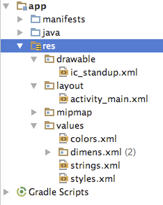
Where are the resources in your project?
resources and resource files
stored in res folder

Slide 53
Refer to resources in code
Layout:
R.layout.activity_main
setContentView(R.layout.activity_main);
View:
R.id.recyclerview
rv = (RecyclerView) findViewById(R.id.recyclerview);
String:
In Java: R.string.title
In XML: android:text="@string/title"

Slide 54
Measurements
Density-independent Pixels (dp): for Views
Scale-independent Pixels (sp): for text
Don't use device-dependent or density-dependent units:
Actual Pixels (px)
Actual Measurement (in, mm)
Points - typography 1/72 inch (pt)
Notes:
On measurements that you should use for your dimensions.
Device independent pixels are independent of screen resolution.
For example, 10px will look a lot smaller on a higher resolution screen, but Android will scale 10dp to look right on different resolution screens.
SP does the same for text size.

Slide 55
Learn more

Slide 56
Learn more
Views:
View class documentation
device independent pixels
Button class documentation
TextView class documentation
Layouts:
developer.android.com Layouts
Common Layout Objects

Slide 57
Learn even more
Resources:
Android resources
Color class definition
R.color resources
Supporting Different Densities
Color Hex Color Codes
Other:
Android Studio documentation
Image Asset Studio
UI Overview
Vocabulary words and concepts glossary
Model-View-Presenter (MVP) architecture pattern
Architectural patterns

Slide 58
What's Next?
Concept Chapter: 1.2 Layouts and resources for the UI
Practicals:
1.2A : Your first interactive UI
1.2B : The layout editor

Slide 59
END

